Slide 1
Introduction to Social Media Analytics (Lec 11)
Hao PENG
Department of Data Science
City University of Hong Kong
https://haoopeng.github.io/

Slide 2
Topics for this week
Network Science
Background
Characteristics of Social Networks
Short average distance
High clustering coefficient
Power-law degree distribution
Social influence/hubs
Strong and weak ties
Community structure
Applications
Community detection
Cascade prediction
Information diffusion
Network visualization

Slide 3
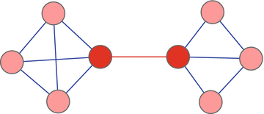
Edge b/w centrality (structure)
Betweenness centrality of an edge is the number of all-pairs shortest paths that pass through the edge.
(Structural definition)
Notes:
To identify influentials

Slide 4
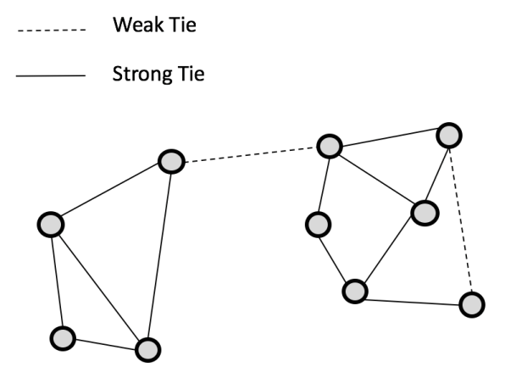
Strong/weak ties (frequency)
Measured by edge weights such as the contact frequency, the number of mutual friends, instead of structural positions.
Strong ties are often seen within communities; whereas weak ties often connect/bridges different communities.
Weak ties often have high betweenness centrality; they tend to be structurally more important! (weak in relationship but strong in global connectivity)

Slide 5
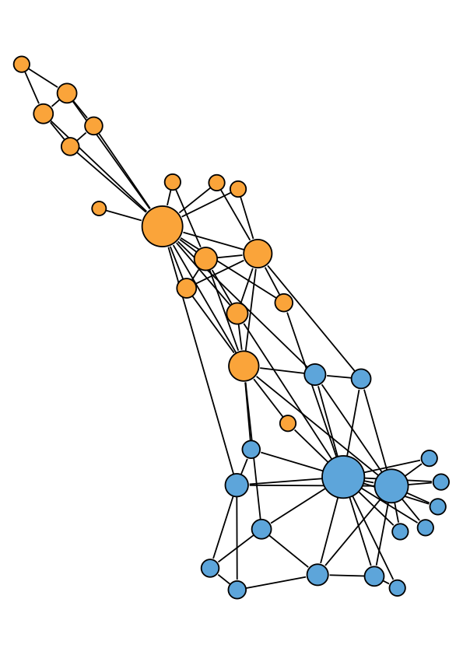
Community structure
Network communities are groups of nodes in a network with lots of connections within the groups and not too many between groups.
Friendship network in a karate club (Zachary 1977)
Notes:
Combine nodes and links

Slide 6
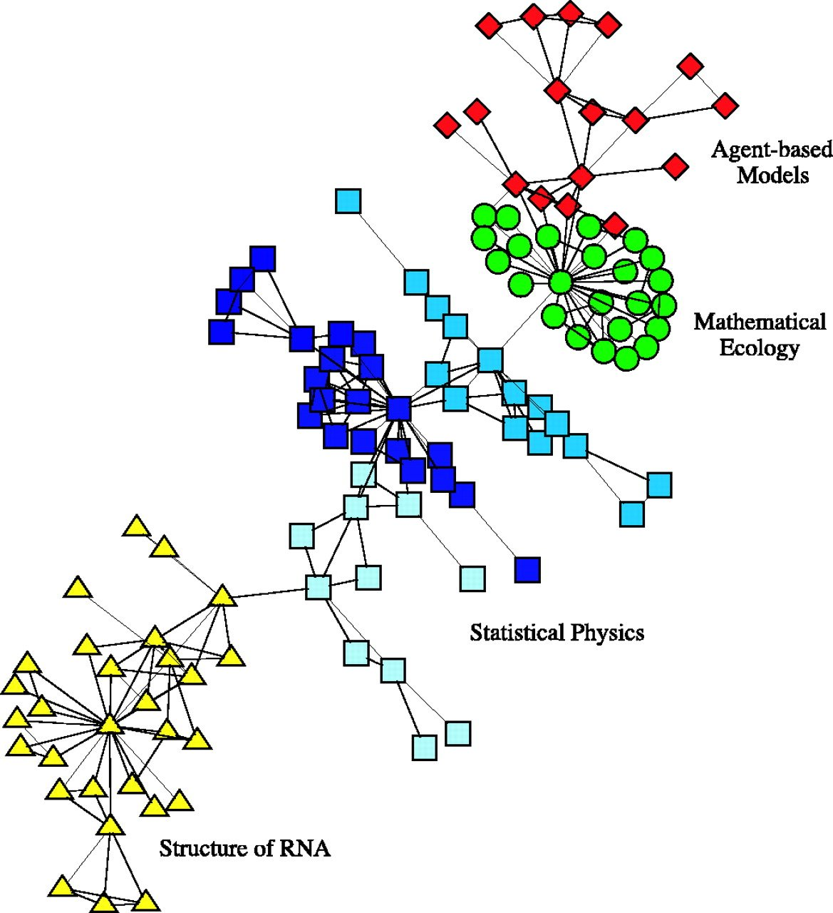
Scientific collaboration networks
Largest component of collaboration network at the Santa Fe Institute.
Mark Newman, PNAS, 2004
Notes:
Co-authorship network

Slide 7
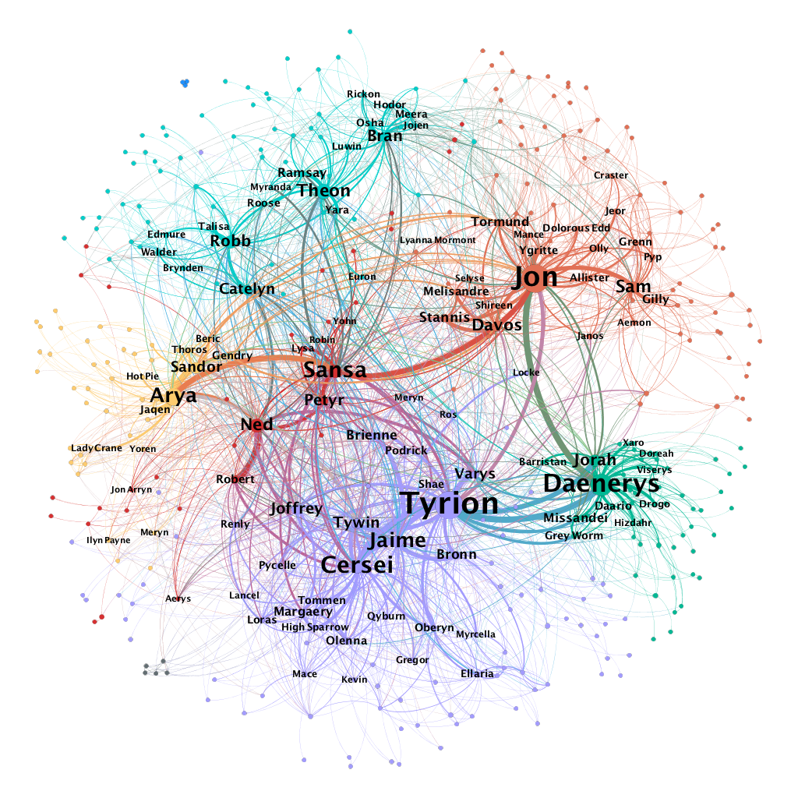
Networks in Game of Thrones
How could we know about the strength of community structure?
Does the observed structure exist due to a random chance?
https://medium.com/web-mining-is688-spring-2021/web-of-thrones-255139b930bb
Notes:
Two actors show up in the same scene

Slide 8
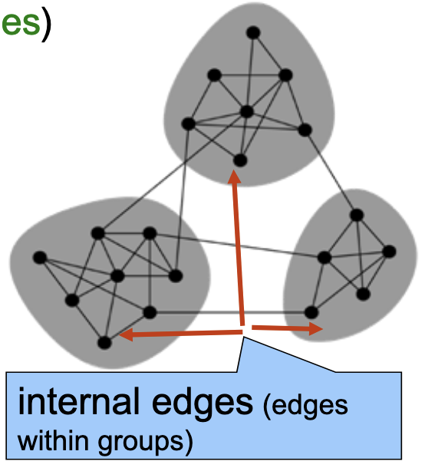
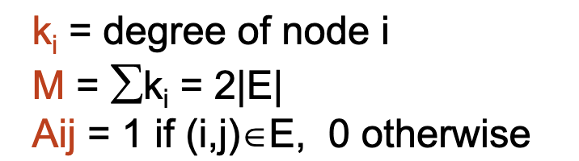
Network modularity (Q)
Modularity Q is the fraction of all edges that fall within the same groups minus the expected fraction if edges were distributed at random.
How to compute the edge density ratio?
/M
Mark Newman, “Modularity and community structure in networks”. PNAS, 2006

Slide 9
Community detection
Network communities are groups of nodes in a network with lots of connections within groups and not too many between groups.
Algorithms for identifying communities:
1. Deploying a hierarchical clustering idea:
Agglomerative (bottom up: successive pairing nodes by adding edges)
Divisive (top down: successive splitting clusters by removing edges)
2. Based on information theory (using random walks)
What are real-world applications of community detection?

Slide 10
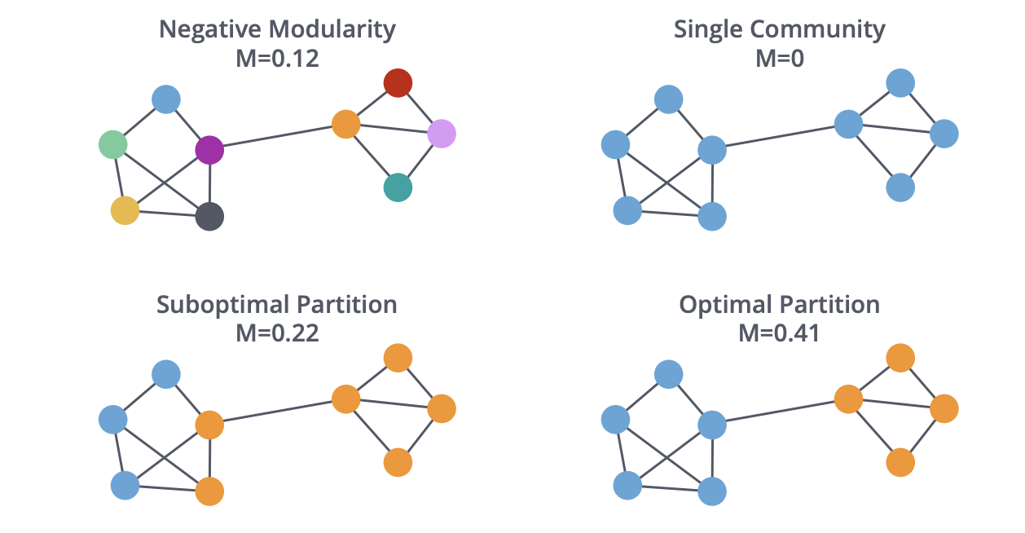
Hierarchical clustering approach
Start from each node as a community:
Start from all nodes in a single community:
Agglomerative clustering
Divisive clustering
Maël Fabien

Slide 11
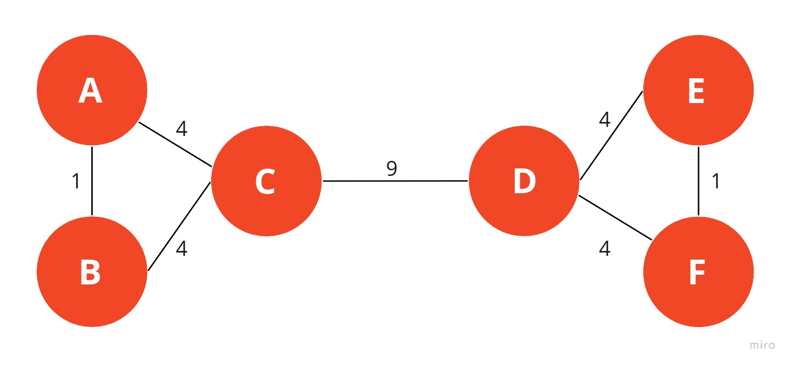
The Newman-Girvan algorithm
Repeatedly removing edges (divisive):
Calculate betweenness scores for all edges in the network.
Remove the edge with the highest betweenness centrality.
Recalculate betweenness for all remaining edges.
Repeat steps 2-4 until there are no more edges left.
Mark Newman, PNAS, 2006; Girvan and Newman, PNAS, 2002
https://memgraph.github.io/networkx-guide/algorithms/community-detection/girvan-newman/
Notes:
In practice, we can build a dendrogram to illustrate the merging process and determine the optimal cut.

Slide 12
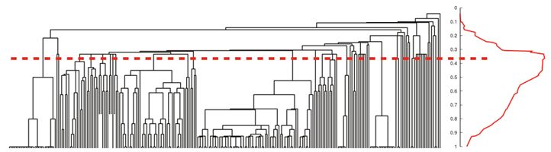
The Newman-Girvan algorithm
Repeatedly remove edges based on betweenness centrality.
It produces a dendrogram for different depth of network partition.
Can use modularity to measure the strength of community structure.
Mark Newman, PNAS, 2006; Girvan and Newman, PNAS, 2002
Notes:
In practice, we can build a dendrogram to illustrate the merging process and determine the optimal cut.

Slide 13
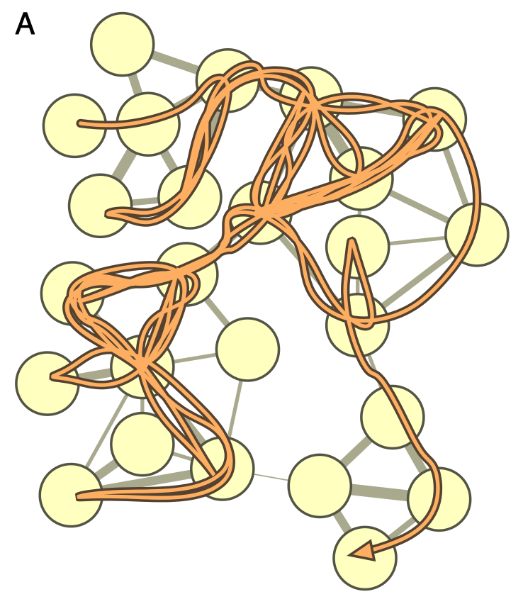
The InfoMap algorithm
Use information theory to describe trajectory of random walks
Task: finding an efficient coding scheme to compress walk paths
Rosvall and Bergstrom. “Maps of random walks on complex networks reveal community structure.” PNAS 2008.
Notes:
Disciplinary and interdisciplinary relationships

Slide 14
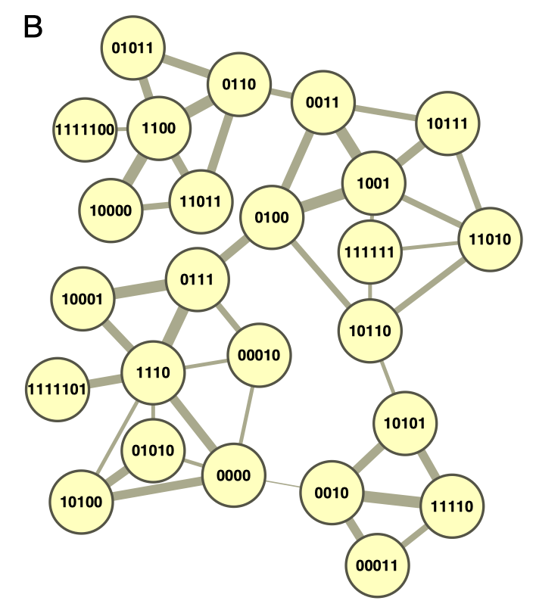
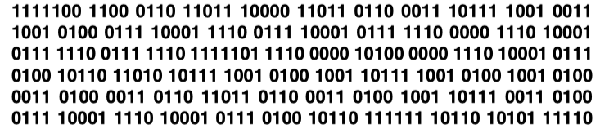
The InfoMap algorithm
Baseline method: give a unique name to each node in the network
For example, use Huffman coding:
How can we do better?
Rosvall and Bergstrom. “Maps of random walks on complex networks reveal community structure.” PNAS 2008.
Notes:
Disciplinary and interdisciplinary relationships

Slide 15
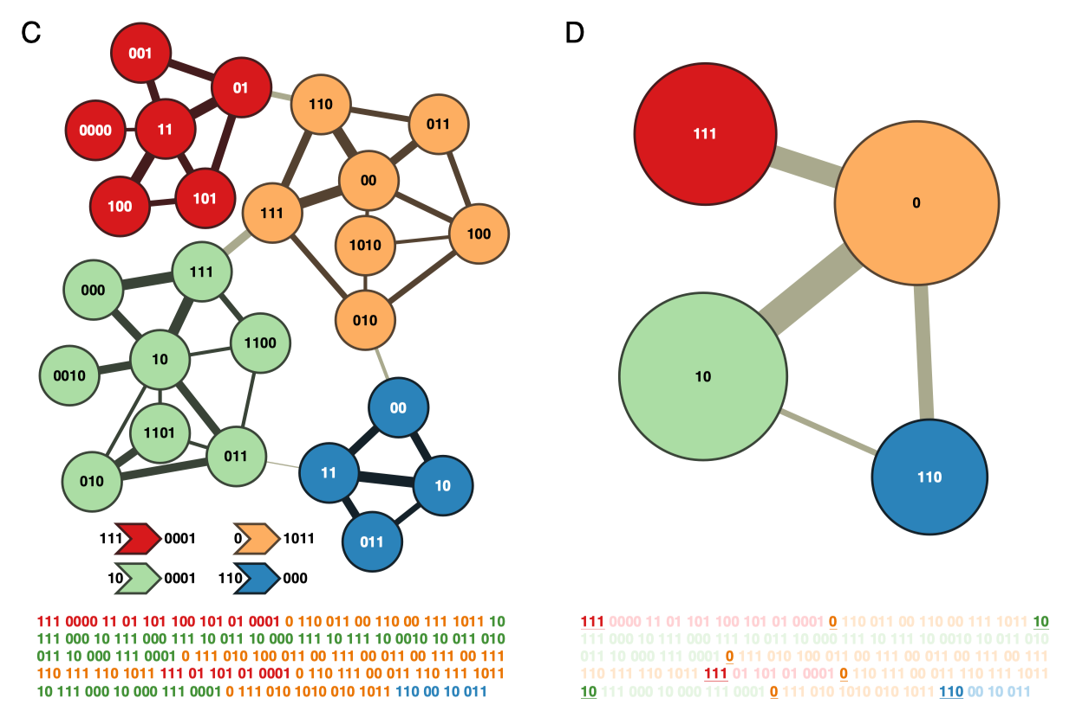
The InfoMap algorithm
A two-level coding scheme:
Major clusters receive unique names (enter/exit codes)
But the names of nodes within clusters are reused
243 vs. 314 bits.
Big improvement!
Treat major clusters as the communities.
Notes:
Disciplinary and interdisciplinary relationships

Slide 16
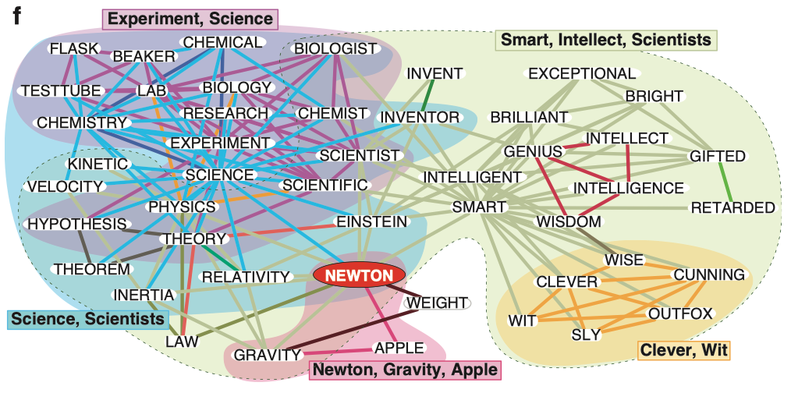
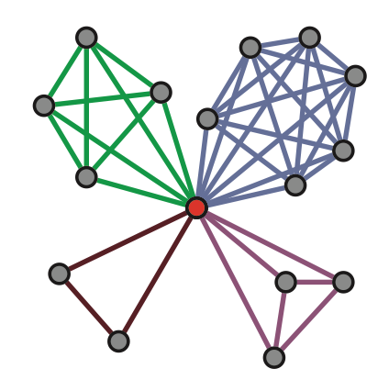
Community detection based on links
The node-level methods partition nodes into disjoint groups.
But a node can (often) belong to multiple communities.
Ahn et al. “Link communities reveal multi-scale complexity in networks.” Nature 2010.
Notes:
Disciplinary and interdisciplinary relationships

Slide 17
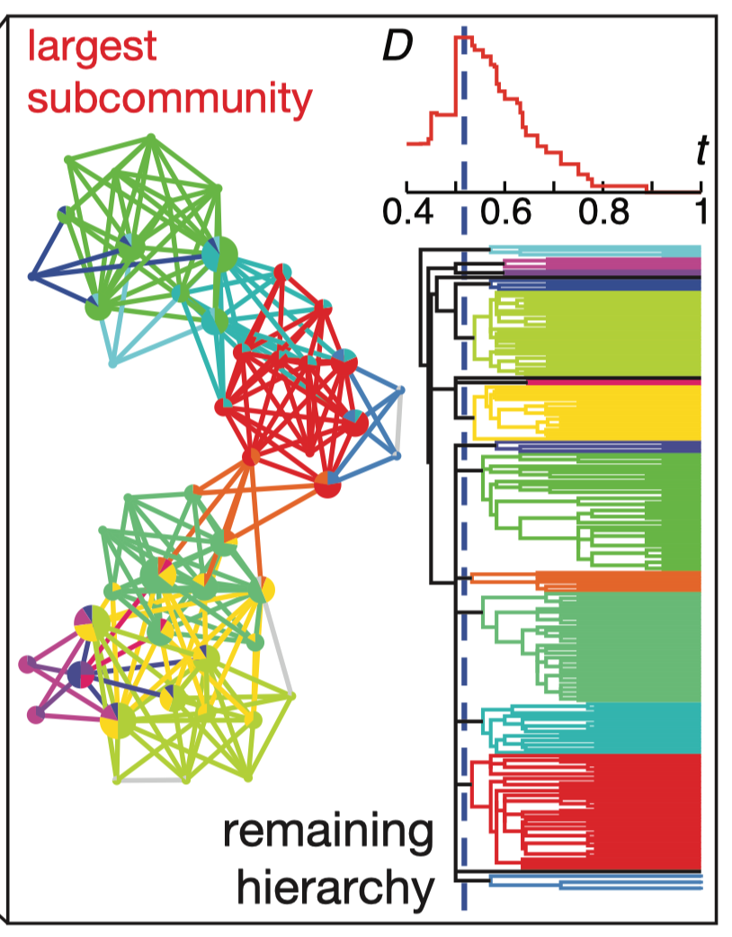
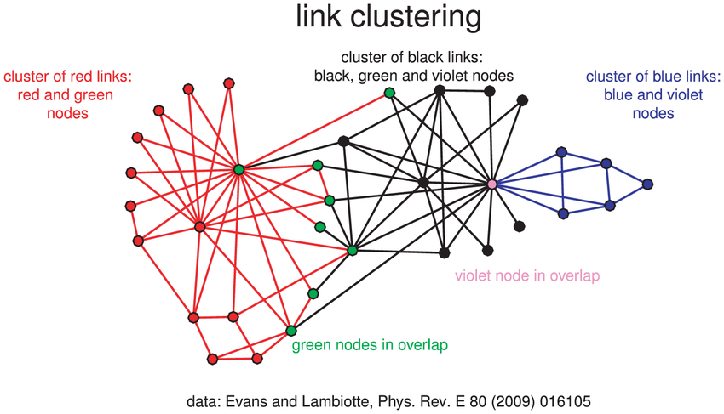
Community detection based on links
Clustering links for finding overlapping node communities
A node can belong to multiple identified link communities
Ahn et al. “Link communities reveal multi-scale complexity in networks.” Nature 2010.
Notes:
Disciplinary and interdisciplinary relationships

Slide 18
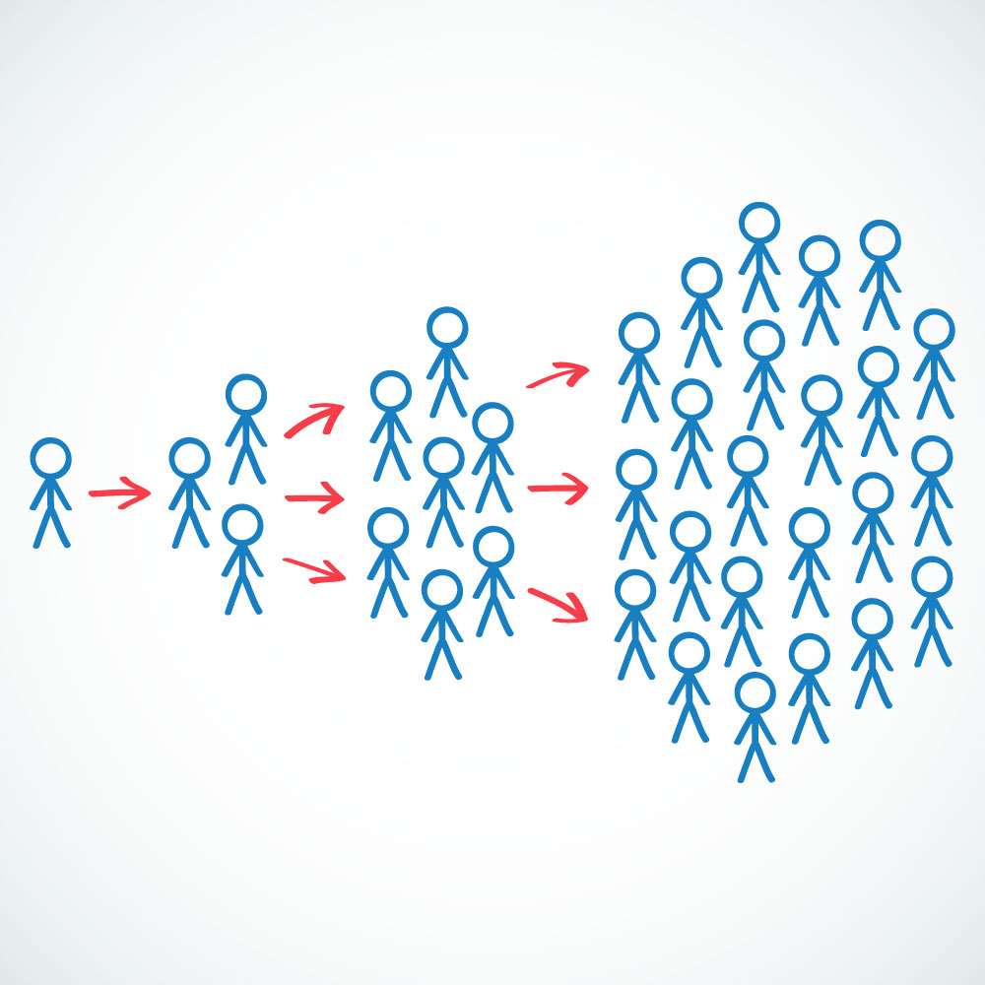
Viral marketing / information diffusion
Knowledge about the network structure can be useful for designing effective marketing campaigns. Why?
Notes:
So far, we have talked about three measures, because knowing about their characteristics can …

Slide 19
Simple vs. complex contagion
Two common information diffusion models:
Independent cascade model (simple contagion)
Information spreads like disease transmission
A node has only one chance to “infect” its neighbors
Each exposure is independent from each other
Linear threshold model (complex contagion Our focus!)
Exposure to multiple neighbors is needed for adoption
Each node has a threshold for activation (count or fraction)
More applicable to the spread of contentious behaviors
(such as wearing mask, voting, jaywalking, new fashion)
More examples?
Notes:
How about joining a gym? Buy an IPhone? Accepting offer from CityU?

Slide 20
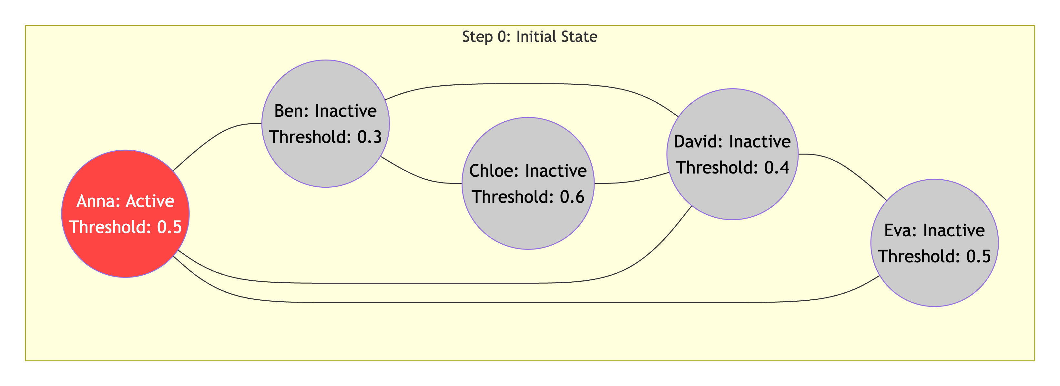
Agent-based modeling
Simulating complex contagion in discrete steps:
Start with a few seed nodes at step 0.
In each step, for each inactive node, check if the fraction of its active friends meets its threshold.
If so, activate the node (it remains active permanently later).
The process unfolds deterministically until no change happens.
Notes:
So far, we have talked about three measures, because knowing about their characteristics can …

Slide 21
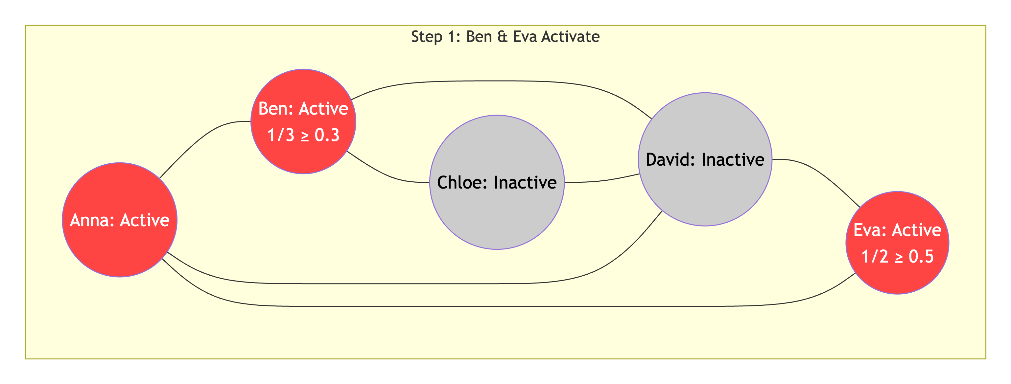
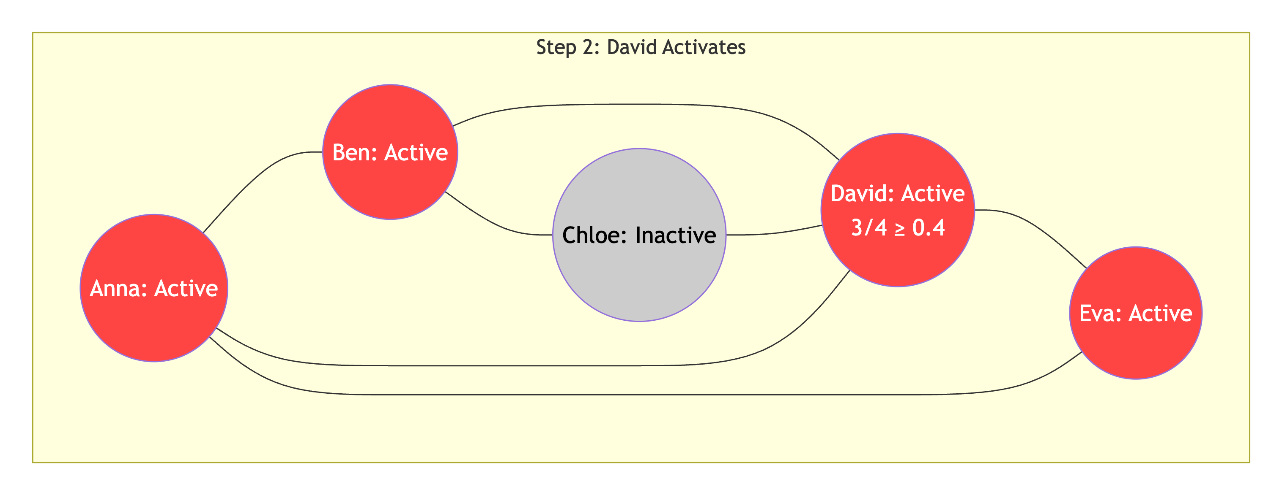
Complex contagion illustration
Notes:
So far, we have talked about three measures, because knowing about their characteristics can …

Slide 22
Strategies for global / large cascade
A global cascade means that every node gets infected in the end.
How can we “infect” the whole network with a limited budget?
How to select seeds? Pick only influential nodes?
Are super stars as important as we think?
Shall we pay attention to the whole network structure?
Notes:
So far, we have talked about three measures, because knowing about their characteristics can …

Slide 23
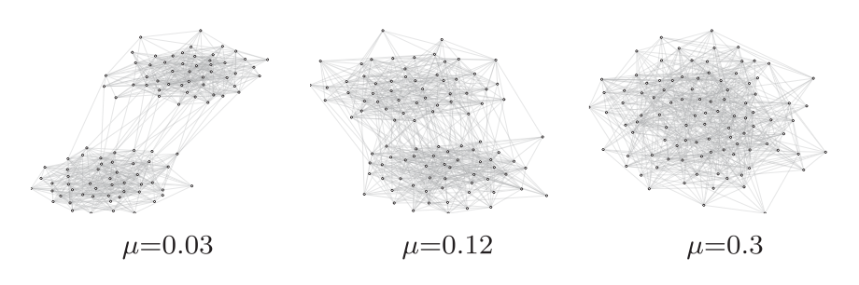
Community structure impacts global cascades more than seed nodes!
A network with 2 equal-sized communities A and B;
Number of nodes and edges are fixed;
Each node has the same threshold 0.35;
Define u as the fraction of edges running between A and B;
Let u control strength of modularity (large u --> weak community);
Randomly activate 20% nodes (as seeds) in A; Calculate cascade size.
A
B
Nematzadeh et al. “Optimal network modularity for information diffusion”. PRL, 2014.

Slide 24
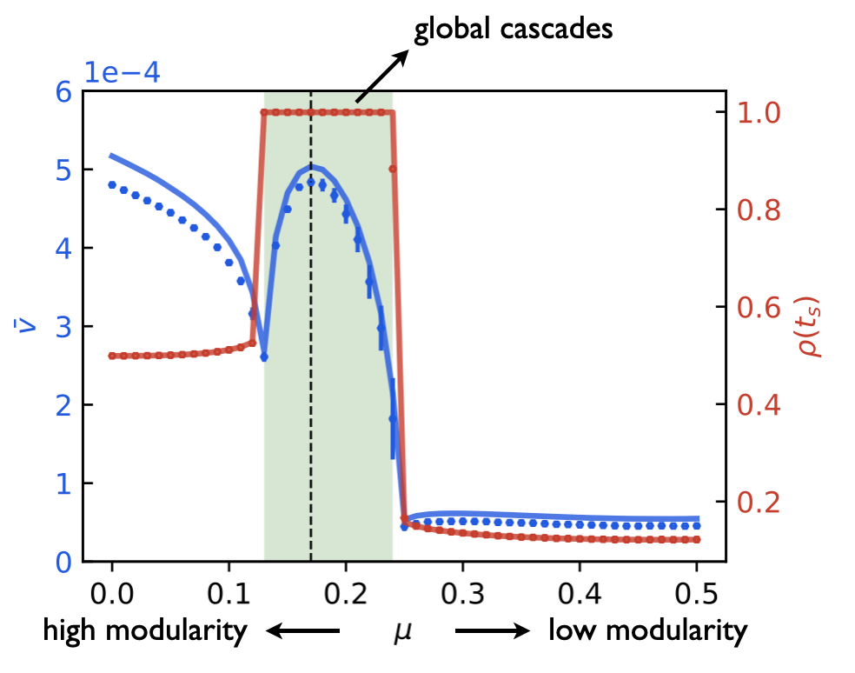
Optimal modularity for global cascade
Blue plot (left y axis):
The diffusion speed
Run 1000 simulations per u using agent-based modeling
Red plot (right y):
The cascade size
Peng et al. “Network modularity controls the speed of information diffusion”. PRE, 2020.

Slide 25
Optimal modularity for global cascade
Fig: With a medium level of community structure, global cascades are guaranteed to happen, no matter how you pick the seeds. Why?
What if you fix the seed nodes, but vary the u ?
Local spreading
(only in A)
No spreading
(even in A)
Peng et al. “Network modularity controls the speed of information diffusion”. PRE, 2020.
Notes:
In other words, if you fix mu, no matter how you pick seeds, it will reach a global cascade.
But, if you fix the seeds, for a network with strong modularity, it will spread locally; for a network with no modularity, it will spread nowhere.

Slide 26
Complex contagion & Cascade
Large cascades don’t depend on highly influential individuals.
Instead, they require a critical mass (early adopter) of easily influenced people connected to other easy-to-influence people.
The key to the spread of complex contagion is to find tightly connected groups of easily influenced adopters where social influence/reinforcement can flow effectively and efficiently.
Community structure can provide enough social influence needed to trigger a global cascade from the early adopters.
Can social influence exist without a network?
Are there examples of cascades without a network?
Notes:
Social influence can exist without a network. E.g. in jaywalking.
As long as social influence can kick in, the magic would still work.

Slide 27

Virality prediction
Memes are units of transmissible information (product, norm, behavior).
Virality prediction: Is this meme going to “infect” x% of the whole network?
Potential useful factors based on the initial stage of sharing:
Meme content
User characteristics
Temporal variation
Network topology
Community structure
https://www.youtube.com/watch?v=XqZsoesa55w
Notes:
We need to consider many factors, such as…
A first hypothesis is that users who are influential/central are the most predictive of virality.

Slide 28
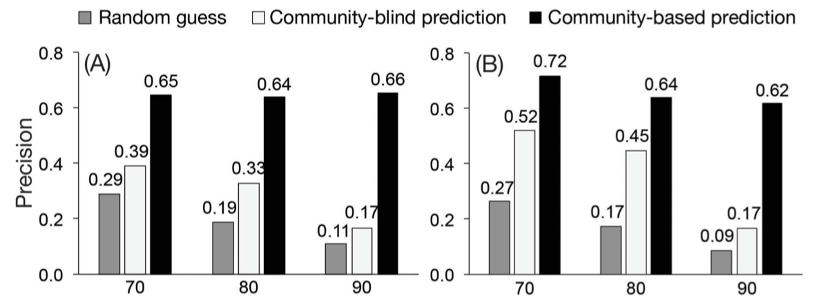
Community structure matters
Basic network features:
Number of early adopters
Number of uninfected neighbors of early adopters
Community-based features (structural):
Number of infected communities
Usage and adoption entropy (measure the strength of concentration)
Fraction of intra-community user interactions
Weng et al. “Virality prediction and community structure in social networks,” Scientific Reports, 2013
Notes:
We need to consider many factors, such as…
A first hypothesis is that users who are influential/central are the most predictive of virality.

Slide 29
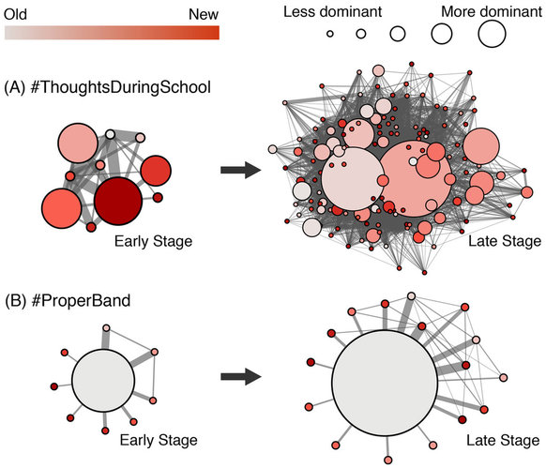
Influential early adopters are not required to produce large cascades
The evolution of a viral meme (#ThoughtsDuringSchool) from the early stage (30 tweets) to the late stage (200 tweets) of diffusion.
The evolution of a non-viral meme (#ProperBand) from the early stage to the final stage (65 tweets in total).
The effect of hubs is often exaggerated on online platforms;)
Weng, Menczer, Ahn. “Virality prediction and community structure in social networks,” Scientific Reports, 2013
Notes:
We need to consider many factors, such as…
A first hypothesis is that users who are influential/central are the most predictive of virality.

Slide 30
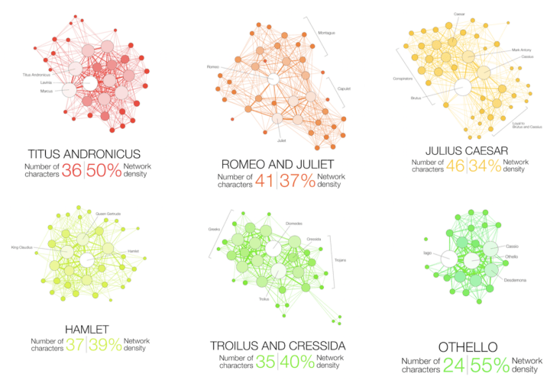
Visualizing networks
http://www.martingrandjean.ch/network-visualization-shakespeare/
Notes:
We want to visualize networks for many reasons: appealing, reveal relationships, structure.
Nodes and links
The longest tragedy Hamlet is not the most complex play.

Slide 31
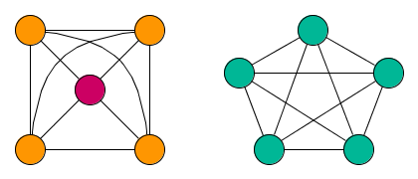
Visualizing networks
Which node is the most central in the left graph?
Which node is the most central in the right graph?
A visualization of a network can be both revealing and deceiving
Visualization is useful for exploration and hypothesis building
Statistical analyses are needed for hypothesis testing

Slide 32
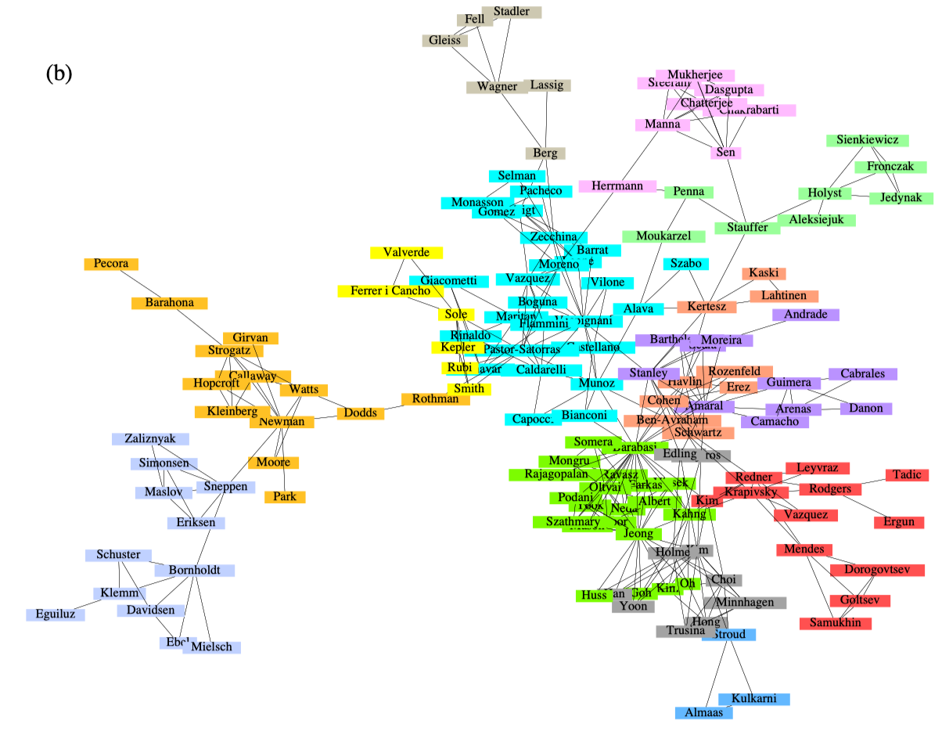
Focusing on communities
Notes:
Disciplinary and interdisciplinary relationships

Slide 33
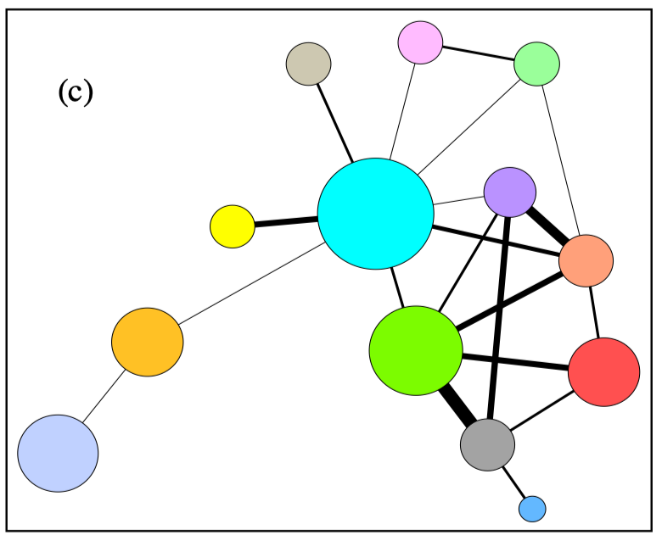
Focusing on communities
Notes:
Disciplinary and interdisciplinary relationships

Slide 34
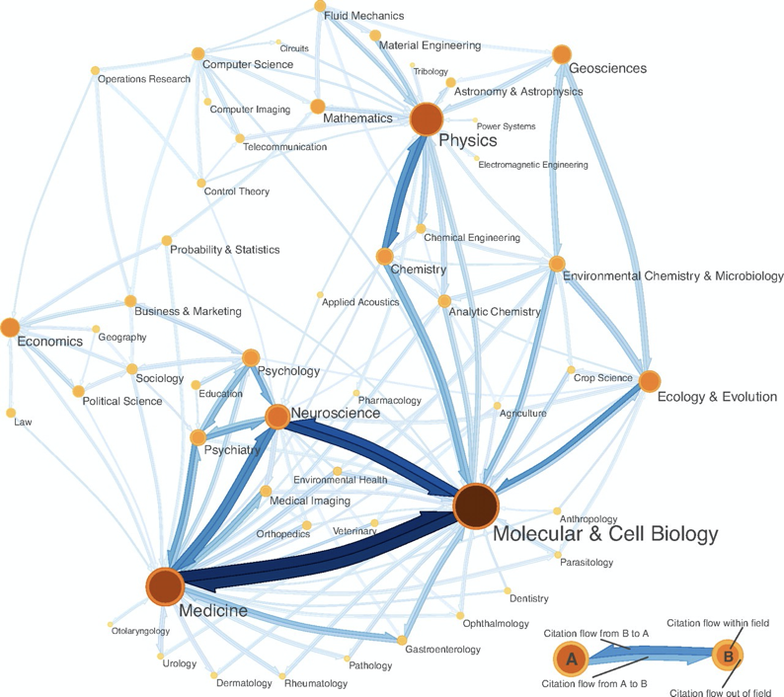
Show node size and link weights
https://www.mapequation.org/infomap/
Notes:
Disciplinary and interdisciplinary relationships

Slide 35
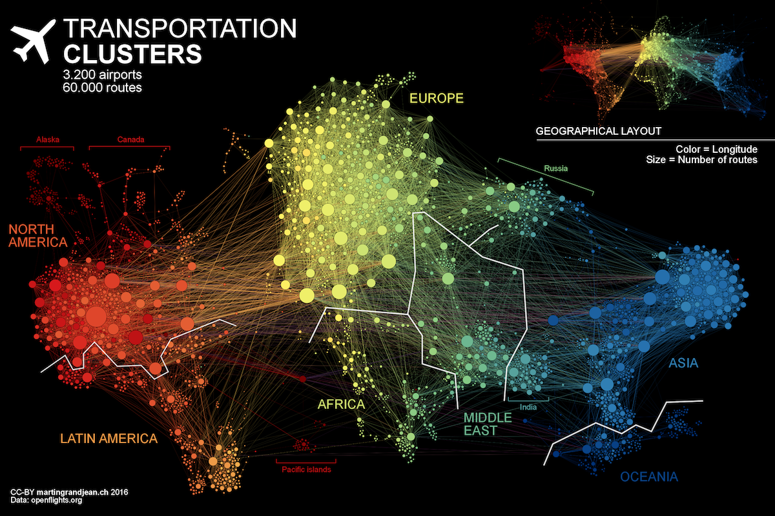
Show node size and link weights
http://www.martingrandjean.ch/connected-world-air-traffic-network/
Notes:
Geographical clusters

Slide 36
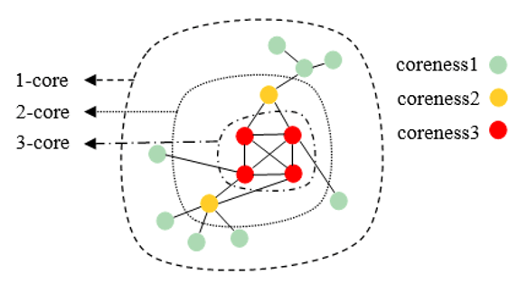
K-score decomposition
K-core: recursively removing all nodes of degree smaller than k, until the degree of all remaining nodes is at least k.
Nodes are said to have coreness k (or, to belong to the k-shell) if they belong to the k-core but not to the (k + 1) -core.
Notes:
Disciplinary and interdisciplinary relationships

Slide 37
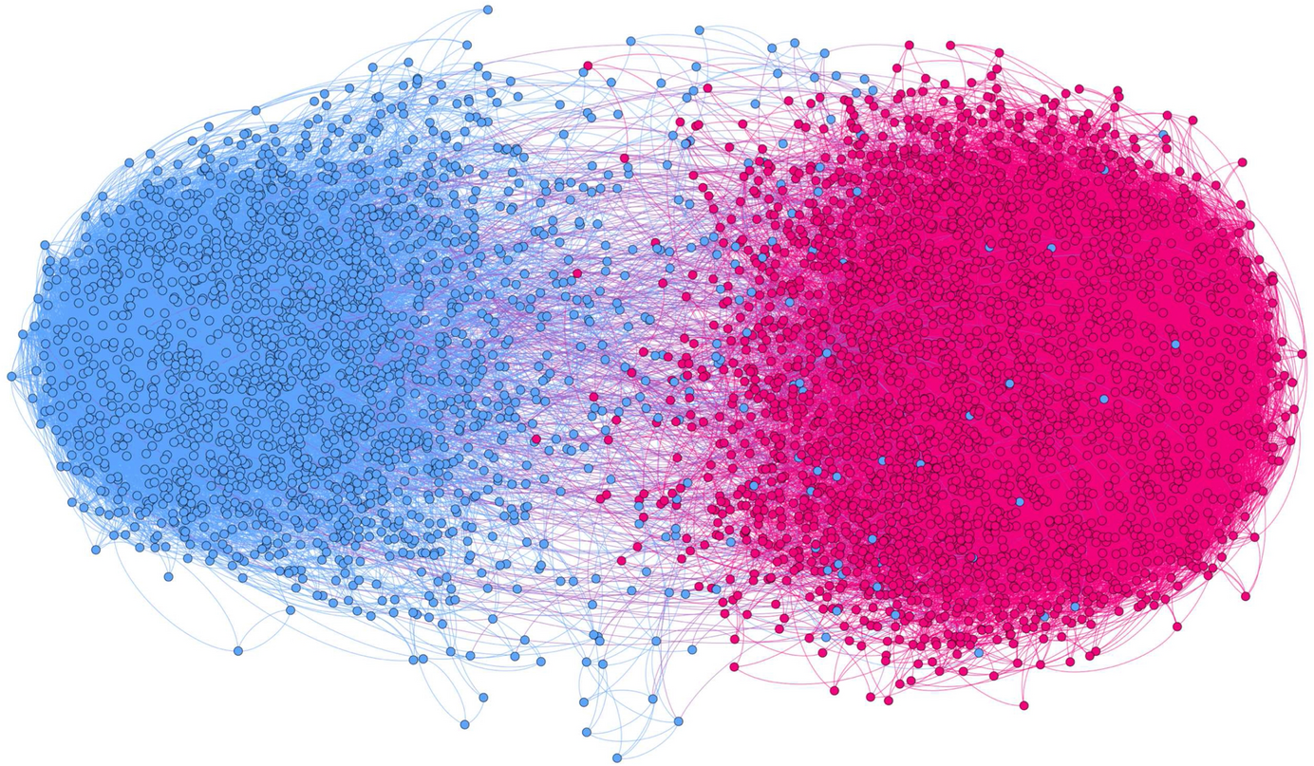
K-score visualization
Example of a politically polarized retweet network (only 3-core nodes are visualized).
https://link.springer.com/article/10.1007/s42001-020-00084-7
Notes:
Disciplinary and interdisciplinary relationships

Slide 38

Interactive network visualization
D3.js: A JavaScript library for producing dynamic and interactive data visualizations in web browsers (cross-platform).
Pre-requisite skills: html, css, javascript
Books: “Javascript by Example”
Online sources: “D3 in Depth” (https://www.d3indepth.com/)
An interactive visualization of the formation of Echo Chambers:

Slide 39


NetworkX
A Python package to create, manipulate, and study the structure, dynamics, and functions of complex networks.
NetworkX has the capacity to operate on very large graphs with more than 10 million nodes and 100 million edges.

Slide 40

LOQ course evaluation survey
Appreciate your valuable feedback!
LOQ system: https://onlinesurvey.cityu.edu.hk/
Also available on Canvas - our course site.
Notes:
Important nodes identified by PR are quite different from that identified by DC.

Slide 41
Course notes
HW3 due next Friday
Start early!
Pay attention to our late policy
Next week agenda:
SMA Ethics
final exam review

